Slide 1


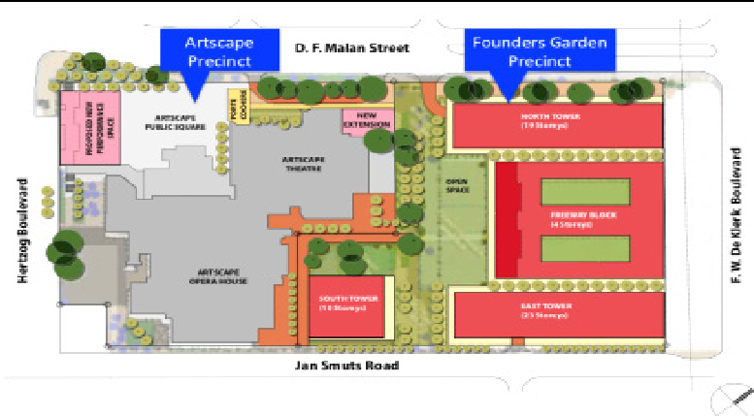












FOUNDERS GARDEN ARTSCAPE
MAP OF THE
PROJECT
The Western Cape Government’s largest mixed use and mixed income housing development in the inner city with over 2,000 residential units, with nearly half dedicated to social housing. The development aims to maximise social housing while promoting sustainable urban growth. The development offers retail and commercial investment opportunities with public amenities like an Early Childhood Development Centre which will support the community.
PROJECT SUMMARY
The project relies on high-value open market unit sales to reduce finance costs and fund social housing. The Residual Land Value has been minimised to mitigate financial risks. Private sector investment will be combined with public subsidies and grants to ensure viability. Investors can engage
in funding mechanisms that maximise social housing provision.
PROJECT STATUS
Bidder procurement phase is nearing conclusion.
FINANCIAL NEEDS
The Western Cape Government is the project owner and landowner, working in partnership with the City of Cape Town to provide Urban Settlements Development Grant. Artscape Theatre. The development will involve private developers and Social Housing Institutions (SHIs) for the social housing component, ensuring successful project delivery. These partnerships are crucial to achieving the project’s mixed-use, mixed-income housing goals.
5 6
PRIVATE SECTOR OPPORTUNITY
This prime city-center site offers a major opportunity for developers seeking to participate in the largest public sector initiated residential, retail, and commercial investment in the inner city. The sale structure allows flexible phasing, generating returns from unit sales and rental income.
KEY PARTIES
1
2
3
4
TIMELINE
Procurement Process: The Western Cape Government will proceed with a procurement process for a Developer.
Land Transfer: Scheduled after the completion of social housing and essential external facilities.
Social Housing Completion:
To be completed first, ensuring that social housing is prioritised.
External Facilities Completion:
Development of necessary public amenities and services, such as the Early Childhood Development Centre and public spaces.
Open Market Units Development: Following social housing completion, the open market units will be developed.
Project Completion: Targeting swift completion post-land transfer to meet urgent housing needs.
SOCIAL & ECONOMIC BENEFITS
± Approximately 1 185 and 291 Social Housing opportunities in the respective towers are envisaged.
.
Direct empowerment of local labour and SMME’s through various contract participation
goals.
Sustainable urban development with a 4 Star Green Building from the GBC.
S.
Strengthened public-private collaboration for long-term investment in infrastructure and housing solutions.

