Slide 1

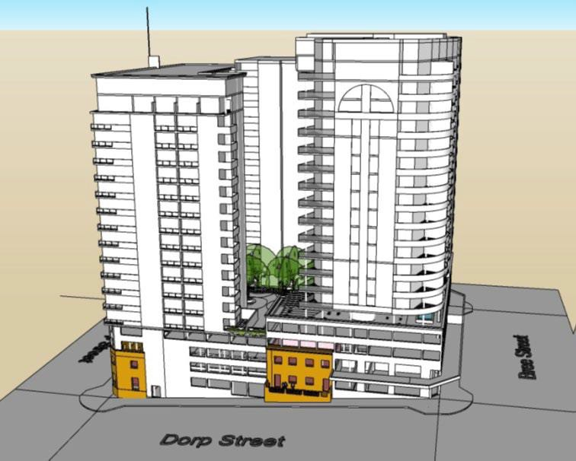







LEEULOOP PRECINCT DEVELOPMENT
Conclusion of developer procurement.
Project to be delivered through the conditional sale of land to a private developer.
Cross-subsidisation model: Open market housing and commercial sales to cross subsidize social housing.
Social housing subsidy to be secured through SHRA grants and residual land value.
Minimum 35% of residential GLA allocated for social housing.
PROJECT STATUS
FINANCIAL NEEDS
Development of a high-rise, mixed-use precinct featuring residential, retail, and office space, incorporating heritage resources.
Potential to contribute over 800 residential opportunities in the inner city,
with a minimum of 35% dedicated to social housing.
PRIVATE SECTOR OPPORTUNITIES
Opportunity for retail on the ground-floor and office space on first-floor.
Sale and/or lease of commercial space and open-market residential opportunities.
Participation in a phased transfer model through a Sale and Development Agreement.
KEY PARTIES
WESTERN CAPE GOVERNMENT: Custodian of the land.
PRIVATE DEVELOPER & INVESTORS
Purchaser and executor of the development. Social Housing Institution as a development partner and executor of social housing.
HERITAGE WESTERN CAPE:
Ensuring compliance with the National Heritage Resource Act.
.
PARICIPATION: Engaged through public participation processes to solicit stakeholder input into development plans.
SOCIAL HOUSING REGULATORY AUTHORITY (SHRA)
Social Housing funding and compliance body.
PRE-DISPOSAL PHASE
July 2026: Conclusion of developer procurement.
DISPOSAL PHASE
Public Participation
Sale and Development Agreement (SADA) concluded.
TRANSFER & SUBDIVISION
Subdivision into two portions for social housing & open market.
Practical completion of social housing required before transfer.
CONSTRUCTION & COMPLETION
Developer executes high-rise development with concurrent open market and social housing phases.
TIMELINE
SOCIAL & ECONOMIC BENEFITS
First public social housing development in the inner city.
Direct empowerment of local labour and SMME’s through various contract participation
goals.
Sustainable urban development with a 4 Star Green Building and Level 1 (Construction Waste) Net Zero Carbon Certification from the GBC.
S.
Strengthened public-private collaboration for long-term investment in infrastructure and housing solutions.

