Slide 1

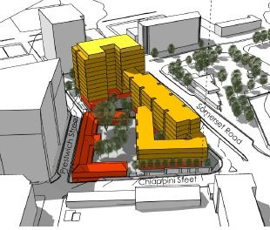









PROVINCIAL PAVEMENT TESTING LABORATORY (PPTL)
The project is in the implementation phase. The tender to procure a developer closes in August 2026.
Approximate value: Capex estimated at just over R300 million. Innovative financing options are under consideration to support infrastructure investment and affordable housing provisions.
PROJECT STATUS
FINANCIAL NEEDS
The project presents multiple opportunities for private sector participation.
Mixed-use development:
Affordable Housing Development:
Infrastructure investment:
Revenue generation:
PRIVATE SECTOR OPPORTUNITIES
Development of residential, retail, and office space, incorporatomg the heritage-graded Soils Lab building.
Minimum of 120 planned housing opportunities will be allocated for affordable perpetual rental housing, requiring innovative delivery mechanisms.
Partnerships for road networks, utilities, and essential services within the development.
Opportunities to cross-subsidise affordable housing with open-market units.
1
2
3
4
KEY PARTIES
WESTERN CAPE GOVERNMENT, CITY OF CAPE TOWN, AND NATIONAL DEPARTMENT OF PUBLIC WORKS & INFRASTRUCTURE: custodians of the land.
PRIVATE DEVELOPERS AND INVESTORS:
Purchaser and executor of the development.
HERITAGE WESTERN CAPE:
Ensuring compliance with the National Heritage Resource Act.
STAKEHOLDER PARTICIPATION: Engaged through public participation processes to solicit stakeholder input into development plans.
2023-2025 Completion of land use and heritage statutory processes including public participation processes.
May 2025 Acquisition of development rights (Record of Decision).
2026 Developer procurement
Still to be Determined: Developer award and site handover.
TIMELINE
SOCIAL & ECONOMIC BENEFITS
Provision of 120 affordable rental housing opportunities in the inner city.
Direct empowerment of local labour and SMME’s through various contract participation
goals.
Sustainable urban development, incorporating environmental and heritage resource considerations.
Strengthened public-private collaboration for long-term investment in infrastructure and housing solutions.

